Slide 1
Data science
The presentation about nothing

Slide 2
resources
Lynda.com ~ $25/$38 per month
Pluralsight.com - $29 per month
Packtpub.com – all you can read online ~$13 per month, 1 free epub download
Google deep learning course - udacity – free online course

Slide 3
Unicorns and rainbows
Steve's Machine Learning Blog

Slide 4
books
Data science from scratch
Code your own neural network
Introduction to the math of neural networks
Even you can learn statistics and analytics
Git – ry’s git tutorial
Try git – code school

Slide 5
Some fundamentals
Neural networks
Machine learning
Deep learning
The maths (some of them)
Statistics
Probability
etc

Slide 6
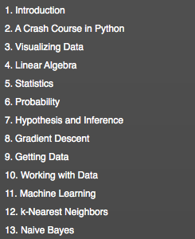
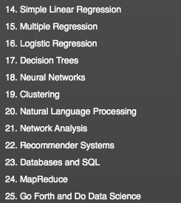
Data science from scratch

Slide 7
video
Understanding Machine Learning with R – pluralsight

Slide 8
Good reads
Turing’s cathedral
The information
In the plex
In pursuit of the unknown – 17 equations that changed the world
Math in minutes
Notes:
Turing’s cathedral – John von Neumann and the Institute for Advanced Study
The information – Information theory
In the plex – Google and how they “buck the norm”
In pursuit of the unknown – 17 equations that changed the world – The maths
Math in minutes – Brief sketch of math on each page

